Slide 1
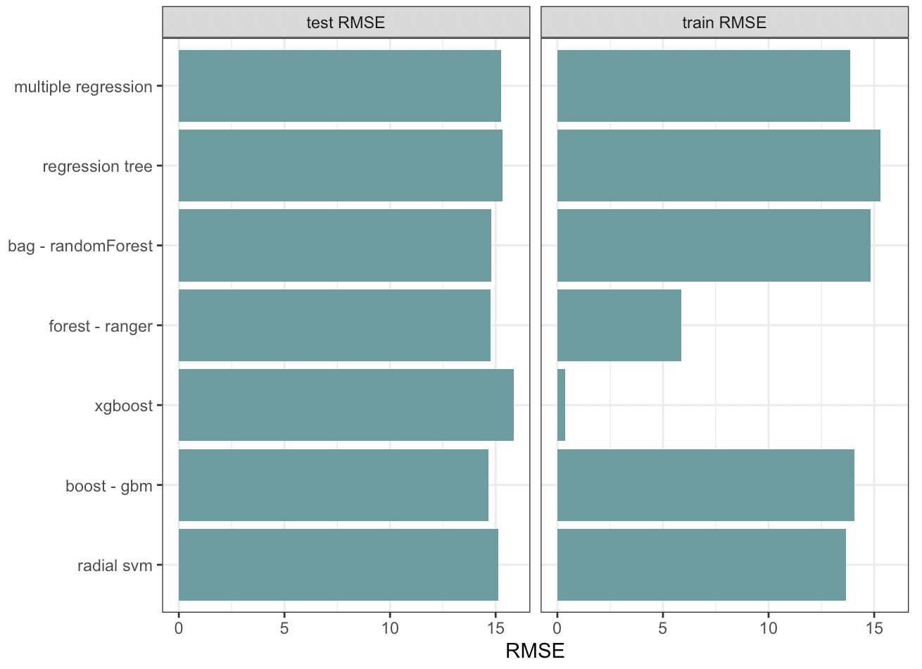
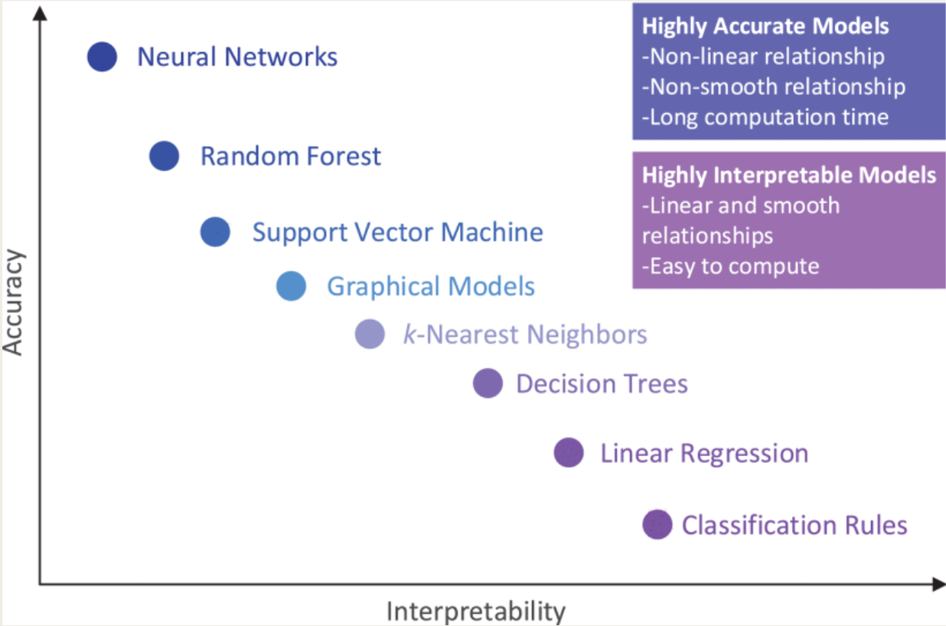
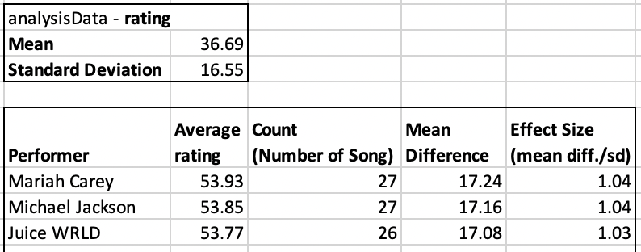

Predictive Analysis Competition Presentation
Critical Steps:
1. Data Exploration
Adequate time spending on data exploration before starting modelling, causing a more structured data analysis process.
2. Data Tidying & Transformation
Categorical Variables
All the categorical variables (including character and logical data types) have been transformed to dummy variables (numeric data type). It allows further machine learning models training.
3. Feature Selection: Reduced predictive modeling’s burden
Variable Inter-set: Only keep common variables of all datasets
Remove Near Zero Variance: Drop less predictive data
Principal Components Analysis:
More efficient than subset selection or shrinkage
Generating linear combinations of original predictors, based on based on similarity measurement (eg. correlation)
Capturing a certain amount of variance
4. Data Analysis – Modeling
I tried various models with default model parameters first. Each predictive model's RMSE (root-mean-square error) will be calculated to measure the model's accuracy for prediction. Then I compared these models' RMSE, and pick the models with lowest RMSE (best accuracy) for further parameters turning.
Some models usually have higher flexibility and accuracy (eg. Bagging, Boosting, Random Forest, Support Vector Machine), while the other models have higher interpretability (eg. Linear Regression). Since our goal is to improve the predictive accuracy, the former are preferrable.
5. Data Analysis – Model Tuning
Random Forest, Ranger, and gbm models are picked to further tuning. After an iterative process, the model’s prediction accuracy became better and better.
Tuned Model Parameters
Changed PCA Parameters
Changed Seed
Model (without tuning) RMSE Comparison
Mistake
Feature Selection (Principal Components Analysis): I did a mistake in coding. I didn't include brackets while indicating the reduced number of components (1664*0.7) for PCA. Although PCA generates linear combinations of original 1664 predictors for predictive modelling, the number of predictors have not been reduced. Interestingly, I re-do the it with correct codes, the results are the same as before.
Future Improvements
Understanding the business indications of data set: Published literature and domain knowledge should help us a lot to understand what features are usually related or not related to a song’s rating.
Feature Selection Approach
Correlation Check: I generated a correlation matrix for all predictors (1664) before PCA, but I gave up because it’s too much to check. However, I should at least check it before I created dummy variables.
Selection for the large amount of variables (eg. genre, perfomer), based on the certain variable’s effect to rating and its frequency of being a song’s feature. For example, filtering out performers with less than 25 songs in dataset, Mariah Carrey has the highest average rating. We should include “Mariah Carrey” as our predictors.
Model Tuning: If time and computer allow, I would like to enlarge the range of parameters for model tuning.

